Slide 1
Sudoku Project
CS 2640 Final Project
Evan Cheng, Bryce Lam, Colin McGough, Loc Nguyen

Slide 2
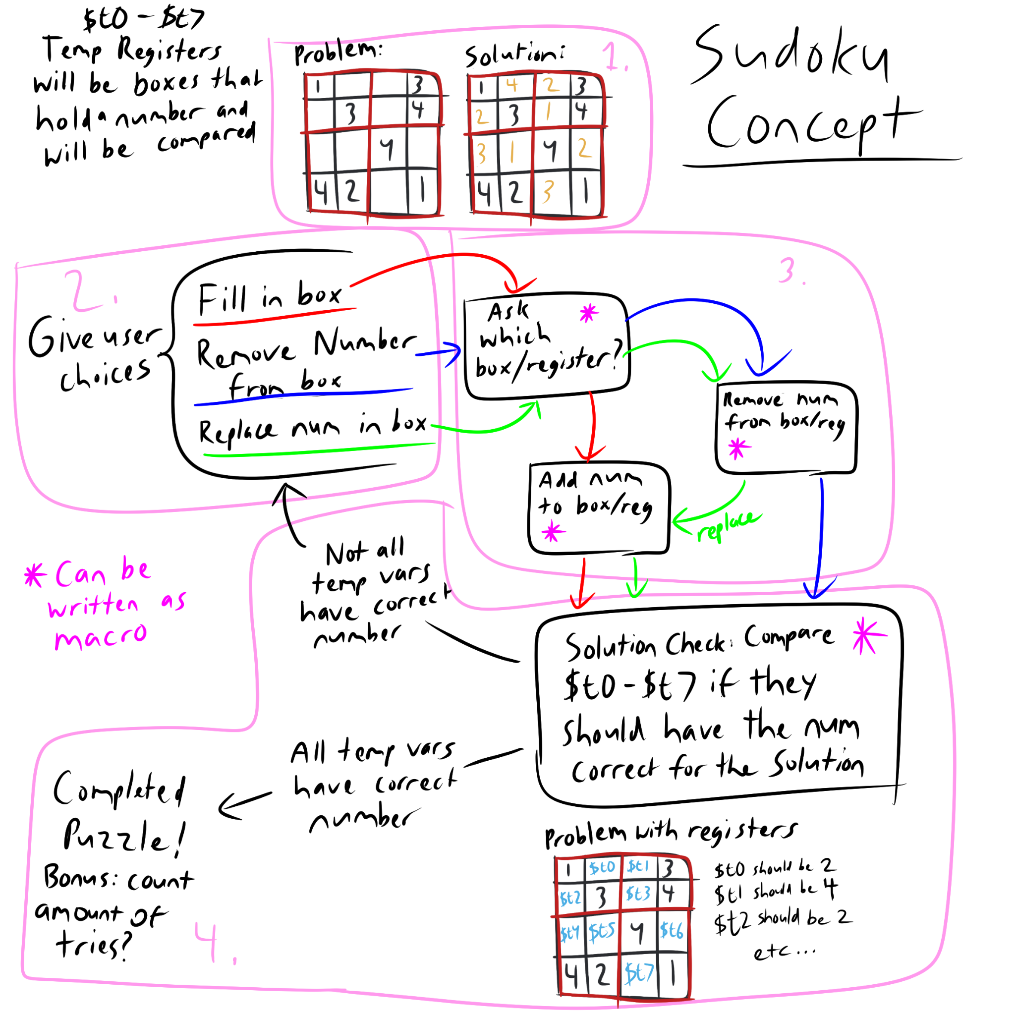
Original Implementation Plan
Notes:
Bryce
4 parts: Create sudoku grid, menu of users’ choices, function of users’ choices checking the solution
Changes in implementation
Use arrays instead of temporary registers to store players’ answers
Instead of menu with three choices, main menu to teach tutorial, play game, exit program

Slide 3
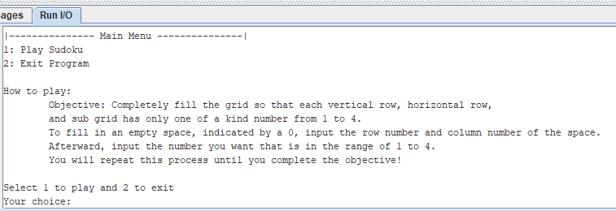
Main Menu
Notes:
Evan
1 to play and 2 exit
Error handling: doesn’t accept other number
Starting up the program, it tells you how to play
Fill the grid so each row and column and subgrid has one of a kind number
Input row number and column number of space
Input a number 1 to 4
Repeat until complete objective

Slide 4
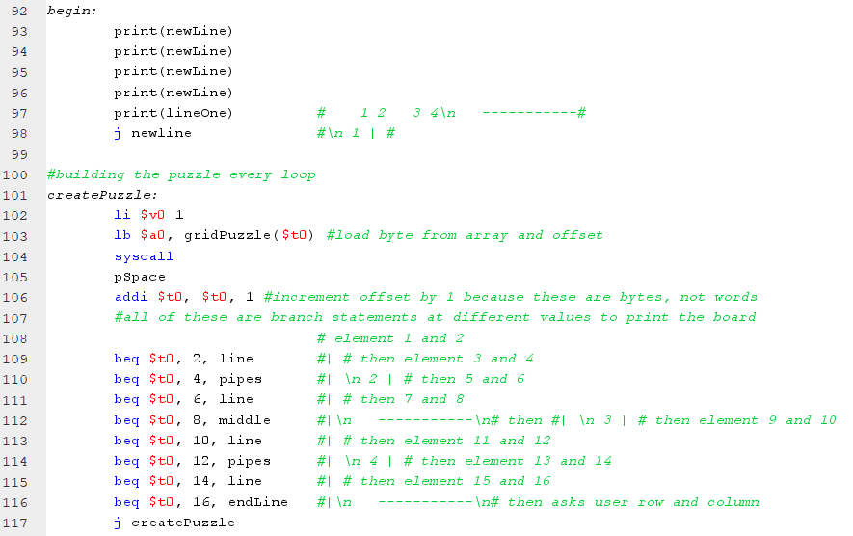
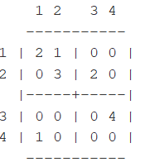
Sudoku Grid
Notes:
Colin

Slide 5
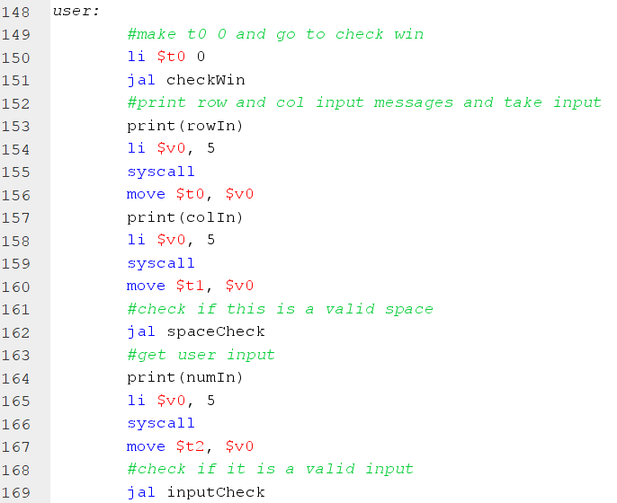
User Input Function & Error Handling
Notes:
Colin (User Input), Bryce (Error Handle)
User Input
Gets row number ($t0), column number ($t1), users’ number ($t2)
Subtract $t0 by 1 and multiply by 4, getting the 1st element of a row
Eg row num 2 - 1 * 4 = 4/5th element
Add $t0 by n value stored in $t1 to get nth element
Store $t2 to nth element of row
Error Handle
After getting user input, jump to check for error
Checks if row and column number are 1-4 and its not for a space that is unchangeable (reg 1,1)
Check if user’s number is between 1-4

Slide 6
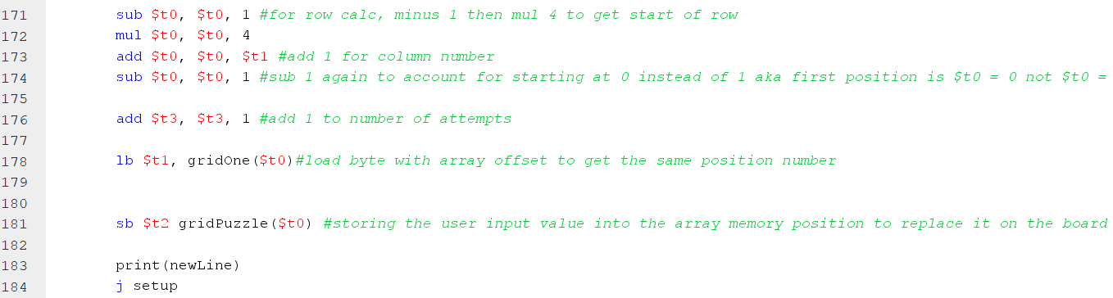
User Input Function
(array)
Notes:
Colin

Slide 7
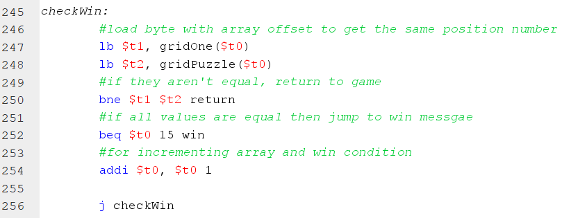
Checking For Solution
Notes:
Loc Nguyen

Slide 8
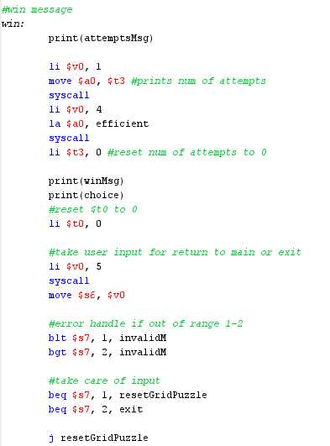
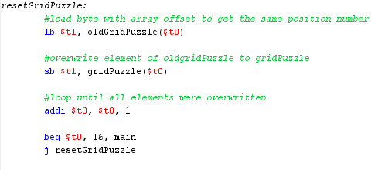
End Screen

Slide 9
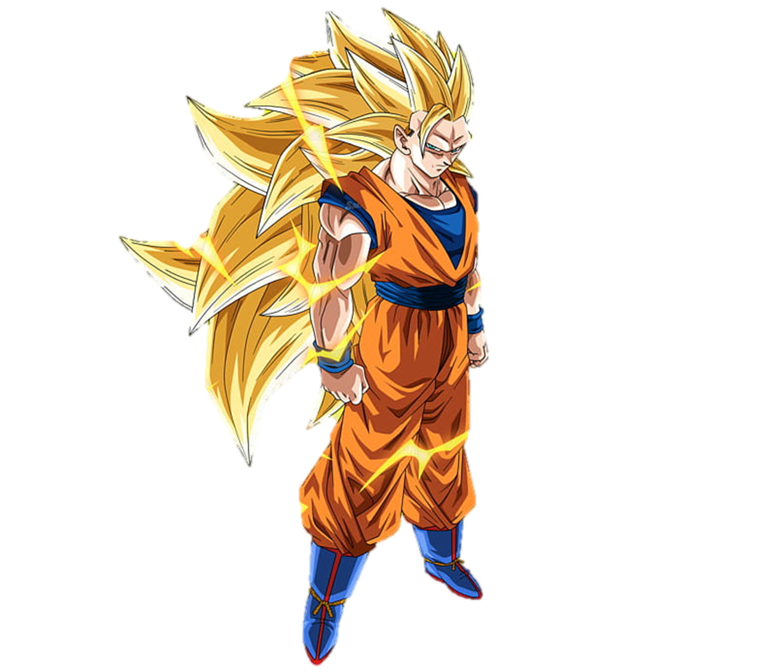


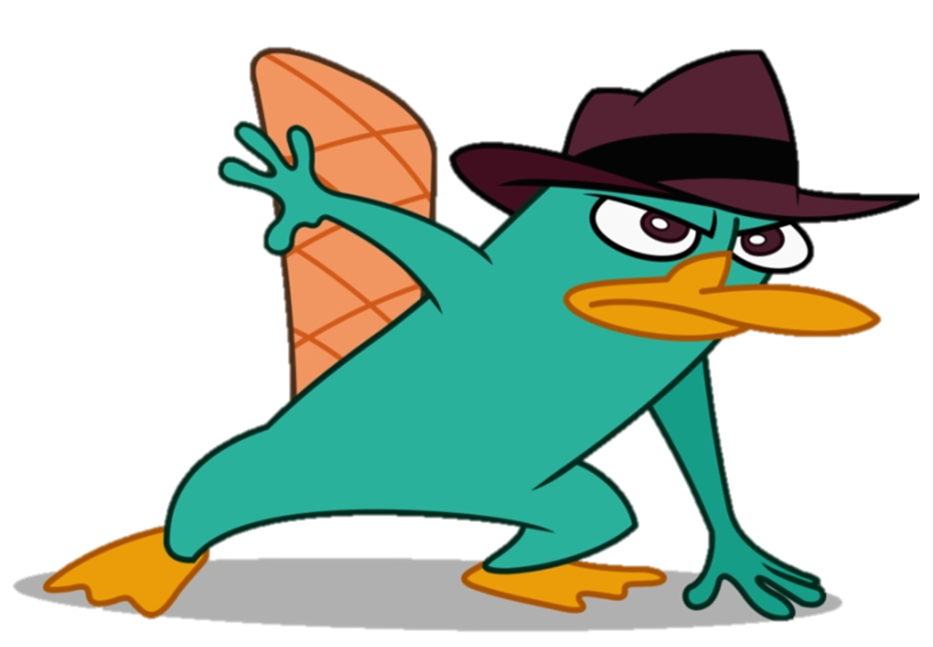
Thanks for listening!

